Slide 1

College “Under-Matching” and Data Science
Tim Yang
November 3rd, 2015

Slide 2
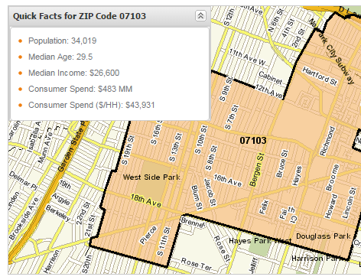
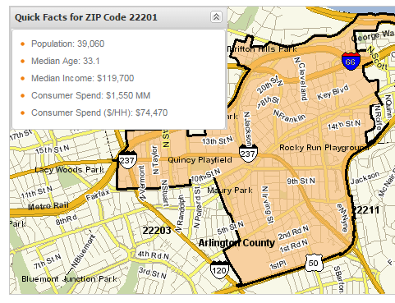
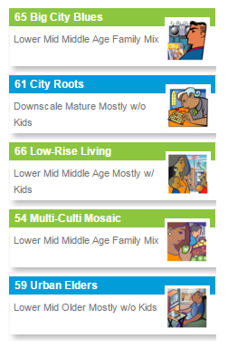
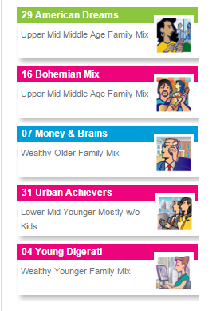
The Struggle is Real
https://www.claritas.com/MyBestSegments/Default.jsp?ID=20&menuOption=ziplookup&pageName=ZIP%2BCode%2BLookup#
07103 - Newark, NJ
22201 - Arlington, VA

Slide 3
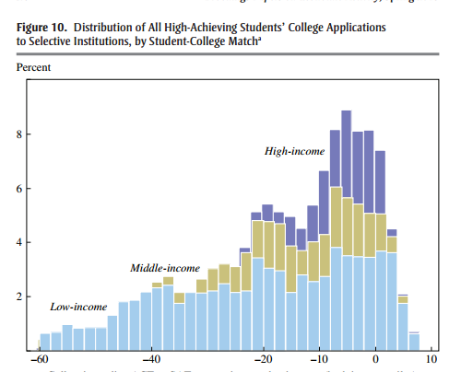
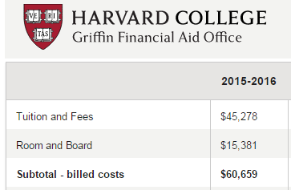
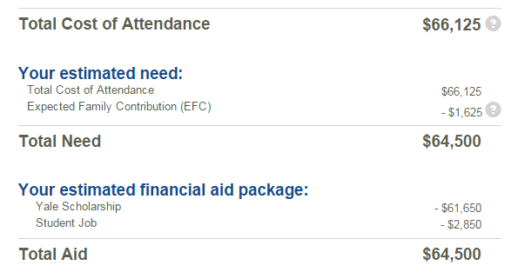
Problem: Higher Education and “Undermatching”
High-achieving students in low-income areas do not “price in” the value/affordability of a elite private/state university degree

Slide 4
Data: White House College Scorecard
Dataset contains information on graduation rate, true costs, and salaries expected per graduate.

Slide 5
Model: TrueCar, TrueCost…TrueCollege?
Proposed
Predicted Output: After 10 years, what is the True Revenue/Expenses of attending this school?
TrueCollege$
REVENUES:
+ $250,000 Median Salary post-tax
+ $240,000 Institutional Grant Aid
+ $35,000 Work Study
x p(Graduation Rate)
EXPENSES:
- $120,000 Tuition Years 1-4
$80,000 Room & Board
$35,000 Stafford Loan Interest
X p(Odds of taking > 4 Years to Graduate)

Slide 6
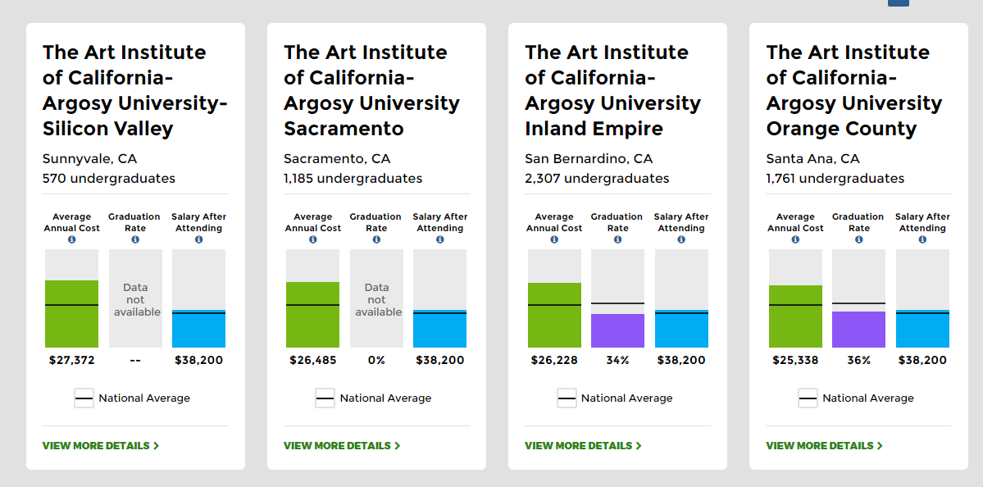
Interesting Finds:
How do we objectively evaluate art school/liberal arts colleges/delineate by major?

